Slide 1

Adult Census Income Prediction
Written By | Gurjeet Singh
Document Version | 0.1
Description | Project Report
Date Issued | 14 November, 2022

Slide 2
Objective:
Development of a predictive model to classify whether a person earns more than 50K dollars per annum or not.. The model will determine the same using some parameters like age, workclass, educational qualifications, country, etc.
Benefits:
Can be used by Governmental / Non-Governmental / Private agencies where people needed to be classified on the basis of their annual income.
For example: in granting scholarships or waivers to needy students, for different schemes by government for poor ones, etc.

Slide 3
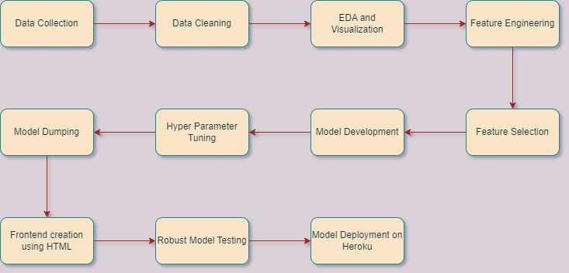
Architecture

Slide 4
Missing Values – All the missing values were replaced with the value being repeated the most number of times.
Numerical Columns - All the numerical features were standardized, preventing any data leakage by using data pipelines.
Categorical Columns - Either label encoding or one hot encoding was done to treat the categorical features
Data Validation and Data Transformation :

Slide 5
Cassandra Database - The dataset was imported to Cassandra database from where we can access it with the help of python.
Insertion of files in the table - All the data is uploaded into a table named “adult” into which is present inside a database named “adult_database”.
Data Insertion in Database:

Slide 6
Data Export from Database:
The accumulated data from database is exported to python and read using pandas.
Performing EDA to get insight of data like identifying distribution, outliers, trend
among data, etc.
Check for null values in the columns. If present impute the null values.
Encode the categorical values with numeric values.
Perform Standard Scalar to scale down the values.
Model Training:

Slide 7
Model Selection
Different classification models were compared and hyperparamater tuning was done via RandomizedSearchCV on the best performing one that is Random Forest Classifier.
Prediction
The model is made in such a way to maximize the accuracy and also other performance metrics so that the predictions are as accurate as possible.
The average accuracy after cross validation was observed to be 90 percent and average F1 score as 89 in 5 validations.

Slide 8
Q & A:
Q1) What’s the source of data?
The data for training is provided by the client in the form answers to certain questions asked which the user has to input.
Q2) What was the type of data?
The data was the combination of numerical and Categorical values.
Q3) What’s the complete flow you followed in this Project?
Refer the Architecture (slide 3) for better Understanding.

Slide 9
Q4) How logs are managed?
Following are the logs that we are using:
modeling like, Data Insertion log, Model Fitting log, prediction log, etc.
Q5) What techniques were you using for data pre-processing?
Removing unwanted attributes.
Visualizing relation of independent variables with each other and output variables.
Checking and changing Distribution of continuous values.
Removing outliers.
Cleaning data and imputing if null values are present.
Converting categorical data into numeric values.
Scaling the data.

Slide 10
Q6) How training was done or what models were used?
First, we started with Data Cleaning, EDA and Feature Engineering and Feature Selection
Then, outliers and ambiguities were removed from the data and categorical features data transformation was applied for categorical columns like one hot encoding, label encoding, etc.
Data pipeline was created to implement data scaling, up sampling using RandomOverSampler and an estimator to prevent any data leakage.
Random Forest model was used as the best estimator which was then used for production followed by hyperparamater tuning.
Q7) How Prediction was done?
Some questions were asked to the client like his age, qualifications, etc. and his responses are taken as inputs which are then fed to the model as a single test case and the predictions are then returned on the clients screen after some seconds in which the data pipeline processes the input data to get the output.

Slide 11
Q8) What are the different stages of deployment?
When the pipeline is ready, we connected the front-end made using HTML with the backend code having the pipeline on the local machine.
A server is created in Flask which just displays a single web page.
The Flask page was then deployed to Heroku cloud.
A corn job was set on the Heroku platform to load the flask app to keep the app connected and running the code forever.

